Slide 1
How do we avoid entrenched and entrained thinking?
A Gurteen Knowledge Café
NetIKX, London, March 2017

Slide 2
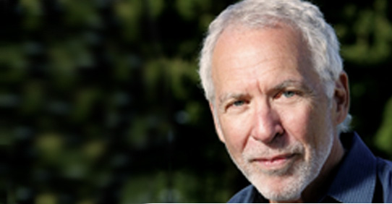
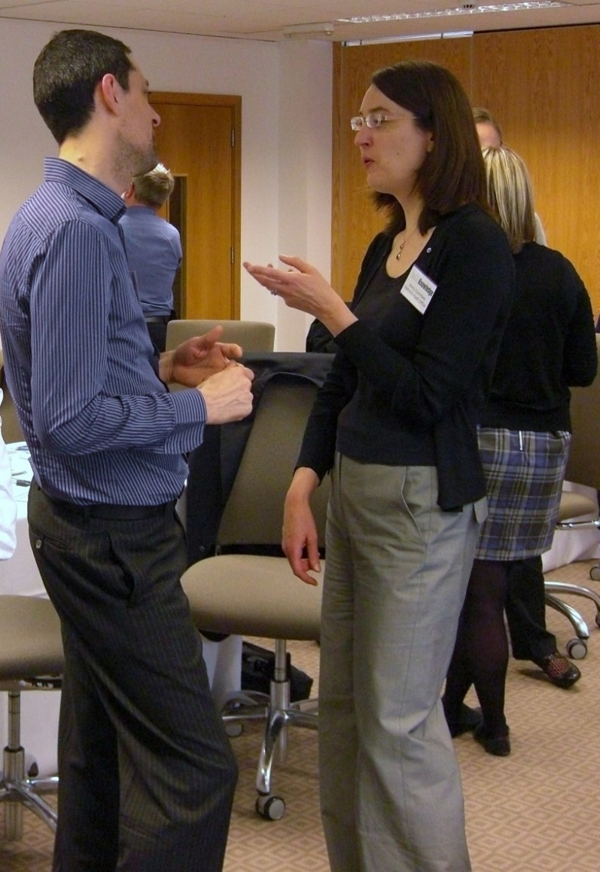
Speed Conversation
We must establish a personal connection with each other.
Connection before content.
Without relatedness, no work can occur.
Peter Block

Slide 3
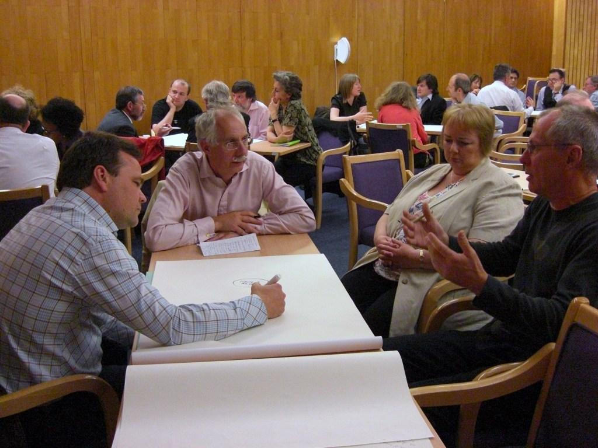
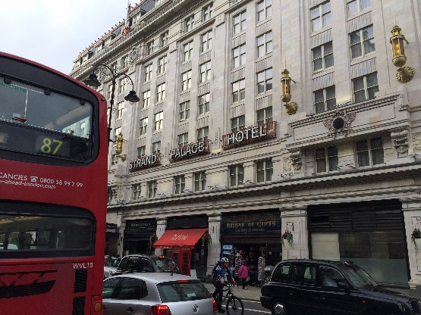
Gurteen Knowledge Café Strand Palace Hotel Sept 2002

Slide 4
The Knowledge Café
The purpose of the Café is to bring a group of people together to have a conversation on a topic of mutual interest
The aims include:
learning from each other
sharing ideas and insights
gaining a deeper understanding of the topic & the issues involved
and exploring possibilities
It also helps:
connect people
improve inter-personal relationships
breaks down organisational silos
improves trust and engagement
It is a social face to face process

Slide 5
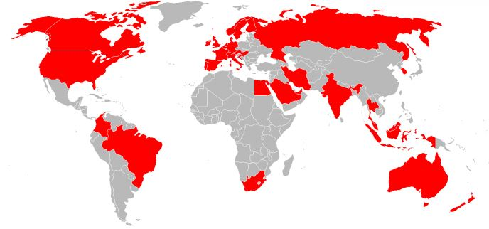
Global Knowledge Cafés
Run regular London Knowledge Cafes
Run them all over the world
Interesting cultural issues
Format always works
People naturally love to talk
London
Knowledge Cafes
PwC
Deloittes
British Library
Cabinet Office
Dept for Business Innovation & Skills
House of Commons Library
Westminster Business School
Cass Business School

Slide 6
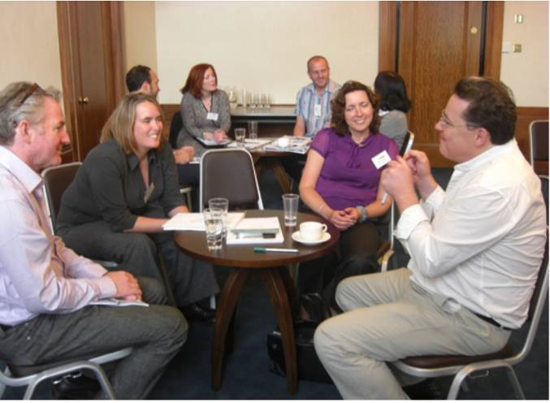
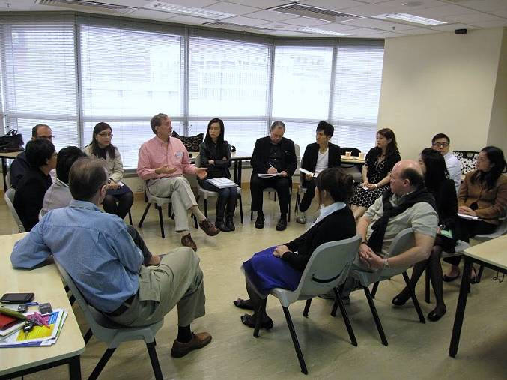
The Knowledge Café Process
Speaker makes short presentation
Poses a question
Small group conversations at tables
Three rounds of conversation
Whole group conversation in a circle
Approx. two hours in total

Slide 7
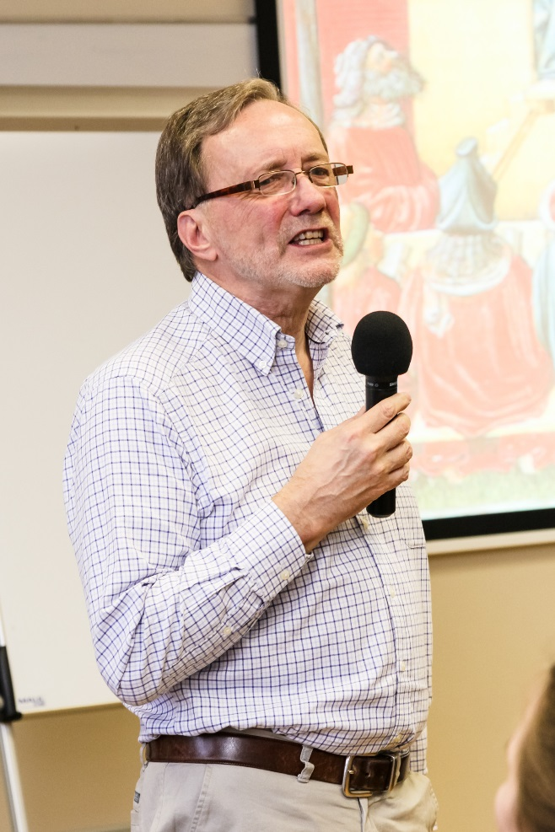
Café Principles
Relaxed, open conversation
Dialogue, not debate
Everyone equal
no table leaders
no reporting back
No one forced to do anything
OK to just listen
Trust people to talk about what is important to them
OK to go off-topic
No attempt to reach consensus

Slide 8
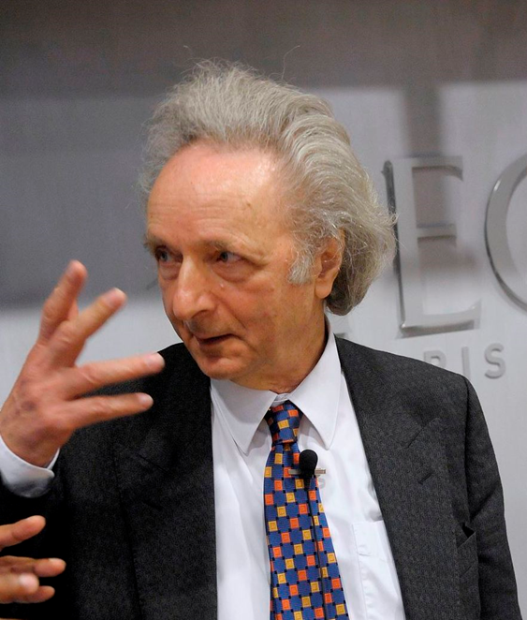
Café Dialogue
Suspend assumptions, do not judge
Observe & listen to one another
Welcome differences & explore them
Allow taboo subjects to be raised safely
Listen to your inner voice
Slow the discussion
Search for the underlying meaning
The kind of conversation I’m interested in is one in which you start with a willingness to emerge a slightly different person.
Theodore Zeldin
Conversation

Slide 9
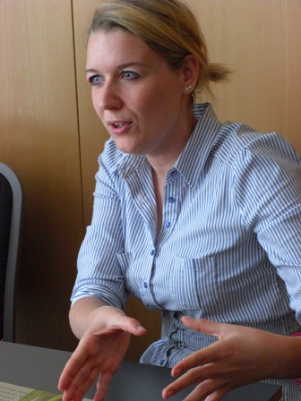
Café Outcomes
Deeper understanding of the issues discussed
Deeper insight into other people’s perspectives
Better appreciation of your own point of view
New ideas and insights
Improved relationships
Position to make more informed decisions
Outcomes are what people take away in their heads

Slide 10
Let’s run a Knowledge Café

Slide 11
How do we avoid [entrenched and] entrained thinking?
Credit: Conrad Taylor

Slide 12
Some barriers to decision making and creative thinking
Cognitive biases are tendencies to think in certain ways that can lead to systematic deviations from a standard of rationality or good judgment
over 200 of them listed on Wikipedia

Slide 13
Entrained Thinking
Entrained thinking is a conditioned response that occurs when people are blinded to new ways of thinking by the perspectives they acquired through past experience, training, and success.
Credit: Dave Snowden & Mary Boone, A Leader’s Framework for Decision Making, Harvard Business Review in 2007

Slide 14
Entrenched Thinking
Entrenched thinking is the lack of desire or ability to accept new ideas – to venture outside the entrenchments.
We are not prepared to listen
We are not prepared to discuss
We know we are right!

Slide 15
Speaking truth to power
To “Speak truth to power” means speaking what you believe to be true to someone in authority who might take it as a criticism or be offended and who has the power to punish you in some way.
Other reasons people don't speak up
Deference to authority (cultural).
Criticism or ridicule (loss of face).
My opinion isn't valued.
Why bother? Nothing happens when I do.

Slide 16
Social Silencing
The spiral of silence or social silencing is a phenomenon where people who think they hold a minority opinion don’t speak up for fear of social exclusion.

Slide 17
Groupthink
Groupthink is a psychological phenomenon that occurs within a group of people, in which the desire for harmony or conformity in the group results in an irrational or dysfunctional decision-making outcome.
Group members try to minimize conflict and reach a consensus decision without critical evaluation of alternative viewpoints, by actively suppressing dissenting viewpoints, and by isolating themselves from outside influences.
Credit: Wikipedia: Groupthink
General Patton once said that if everyone agrees then no one is thinking.

Slide 18
Group polarization
Group polarization refers to the tendency for a group to make decisions that are more extreme than the initial inclination of its members.
These more extreme decisions are
towards greater risk if individuals’ initial tendencies are to be risky
and towards greater caution if individuals’ initial tendencies are to be cautious.
Credit: Wikipedia: Group Polarization

Slide 19
Facilitator Bias
Facilitator bias is the personal, often unconscious bias by the facilitator of a meeting who may unwittingly influence the group in a particular direction or towards a specific outcome.
Credit: Wikipedia: Cognitive Bias

Slide 20
Let’s pose some questions

Slide 21
Question 1
What factors in people’s backgrounds, and professional education, lead to them to having a ‘blinkered’ view of the range of available opinions and policy decisions, especially at work?
How might this be mitigated?

Slide 22
Question 2
When we meet together in groups to discuss and decide, what meeting dynamics get in the way of considering the broadest possible range of opinions and inputs?
How could we run such meetings differently and obtain better results?

Slide 23
Question 3
What factors in people’s backgrounds, and professional education, lead to them to having a blinkered view of the range of available opinions and policy decisions, especially at work? How might this be mitigated?
When we meet together in groups to discuss and decide, what meeting dynamics get in the way of considering the broadest possible range of opinions and inputs? Could we run such meetings differently and obtain better results?
What are the first two questions forgetting to consider?

Slide 24
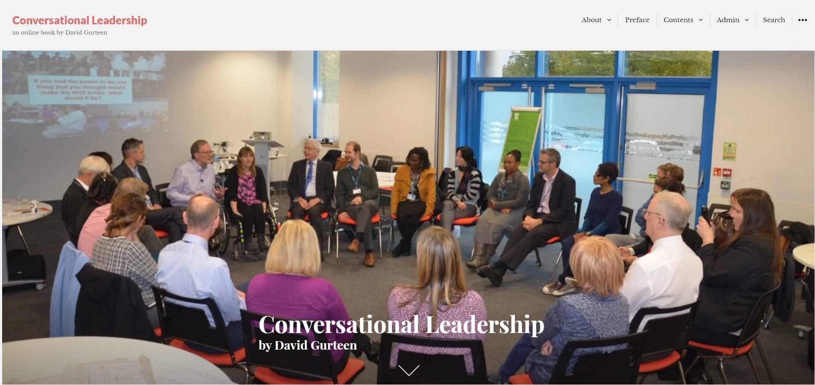
conversational-leadership.net
knowledge.cafe

Slide 25
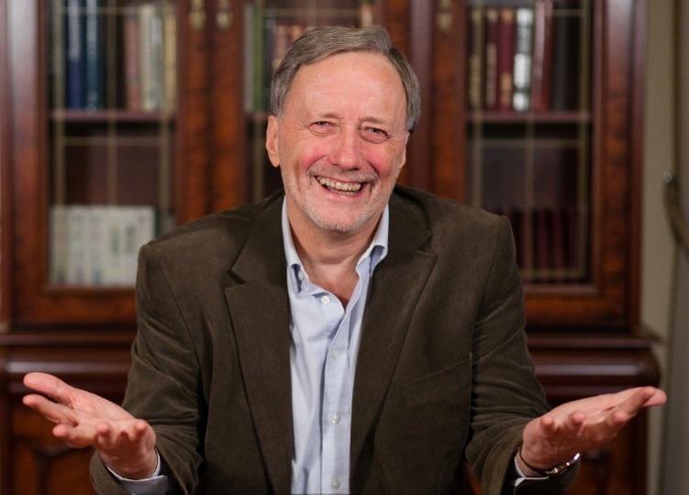
www.knowledge.cafe
David GURTEEN
Gurteen Knowledge
Fleet, England
Tel: +44 7774 178 650
Email: david.gurteen@gurteen.com

Slide 26
Licence
You may use these slides under the following Creative Commons Licence
Attribution-Share Alike 2.0
http://creativecommons.org/licenses/by-sa/2.0/uk/

